Slide 1
CSCI 631 Foundations of Computer Vision
Ifeoma Nwogu
ion@cs.rit.edu
Lecture 6 – Color and Texture

Slide 2
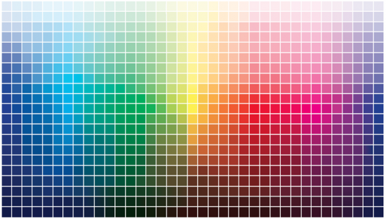
What is color?
Color is a psychological property of our visual experiences when we look at objects and lights, not a physical property of those objects or lights (S. Palmer, Vision Science: Photons to Phenomenology)
Color is the result of interaction between physical light in the environment and our visual system

Slide 3
What is color?
Color is the property possessed by an object to produce different sensations on the eye as a result of the way the object reflects or emits light.
Color is the result of the interaction between physical light in the environment and our visual system

Slide 4
Color
Human encoding of color
Color representation
Applications in computer vision

Slide 5
Overview of Color
Human encoding of color
Color representation
Applications in computer vision

Slide 6
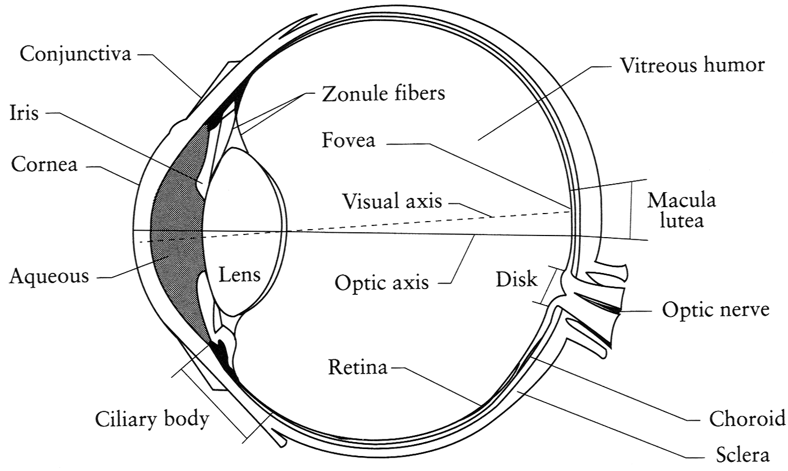
The Eye
The human eye is a camera! But what’s the “film”?
Lens - changes shape by using ciliary muscles (to focus on objects at different distances)
Pupil - the hole (aperture) whose size is controlled by the iris
Iris - colored annulus with radial muscles
Retina - photoreceptor cells (cones and rods) – “the film”
Slide by Steve Seitz

Slide 7
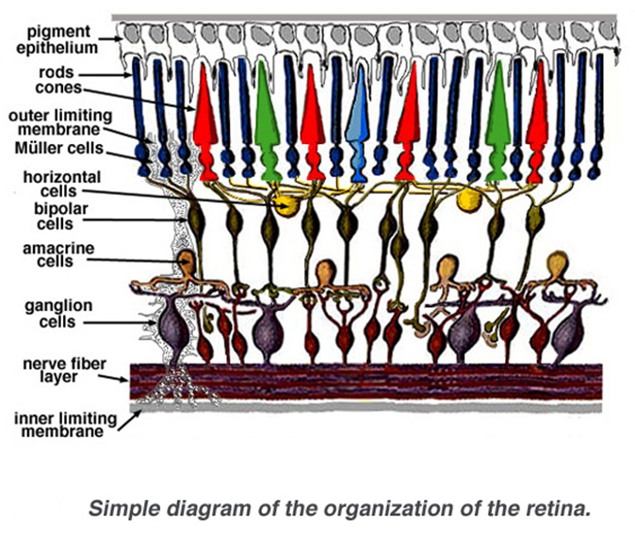
The Retina

Slide 8
Light sensitive receptors
Cones
responsible for color vision
less sensitive
operate in high light
Rods
responsible for gray-scale vision (intensity based perception)
highly sensitive
operate at night
Rods and cones are non-uniformly distributed on the retina
Fovea - Small region (1 or 2°) at the center of the visual field containing the highest density of cones – and no rods
pigment molecules
Slide by Steve Seitz

Slide 9
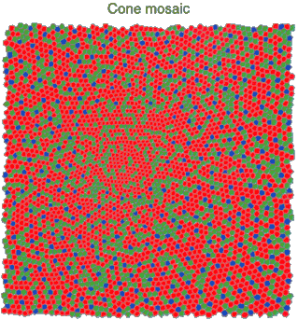
Physiology of color vision
Three kinds of cones:
Ratio of L to M to S cones: approx. 10:5:1
Almost no S cones in the center of the fovea
S, M and L cones are respectively sensitive to short-,
Medium- and long-wavelength lights
© Stephen E. Palmer, 2002

Slide 10
Color
Human encoding of color
Color representation
Applications in computer vision

Slide 11

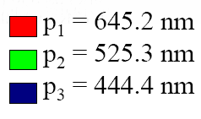
Linear color spaces: RGB space
Primaries are monochromatic lights (for monitors, they correspond to the three types of phosphors)
RGB primaries

Slide 12
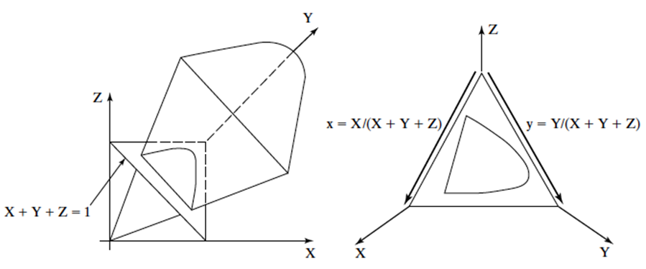
Linear color spaces: CIE XYZ
Established by the commission international d’eclairage (CIE), 1931
Usually projected for 2D visualization as:
(x,y) = (X/(X+Y+Z), Y/(X+Y+Z))
The Y parameter corresponds to brightness or luminance of a color
Volume of all visible colors in CIE XYZ
cone with vertex at origin
Intersect the cone with plane X+Y+Z =1 to
Get the 2-d CIE XYZ space

Slide 13
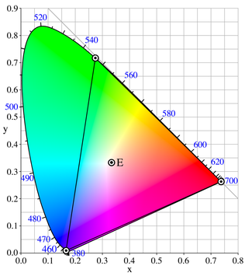
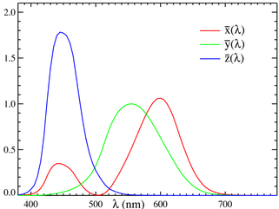
Linear color spaces: CIE XYZ
Matching functions
http://en.wikipedia.org/wiki/CIE_1931_color_space

Slide 14
Distances in color space
Since it is hard to reproduce color exactly, it is important to know whether a color difference would be noticeable to a human viewer.
therefore, compare the significance of small color differences to several people
Humans can determine just noticeable differences, which when plotted form boundaries of indistinguishable colors.
In CIE XY, the properties of these boundary ellipses depend on where in the space they occur
Euclidean distance is therefore a poor indicator of the significance of color differences.
distances in coordinate space would better represent the difference between 2 colors

Slide 15
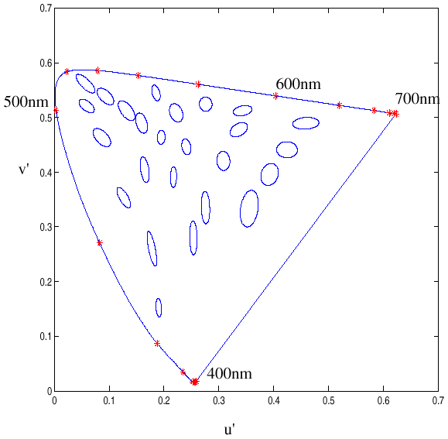
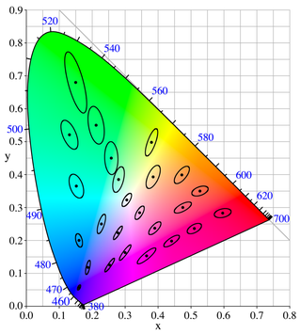
Uniform color spaces
Unfortunately, differences in x,y coordinates do not reflect perceptual color differences
CIE u’v’ is a projective transform of x,y to make the ellipses more uniform
McAdam ellipses: Just noticeable differences in color

Slide 16

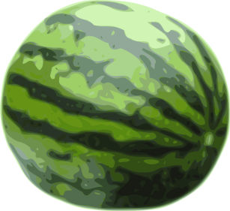
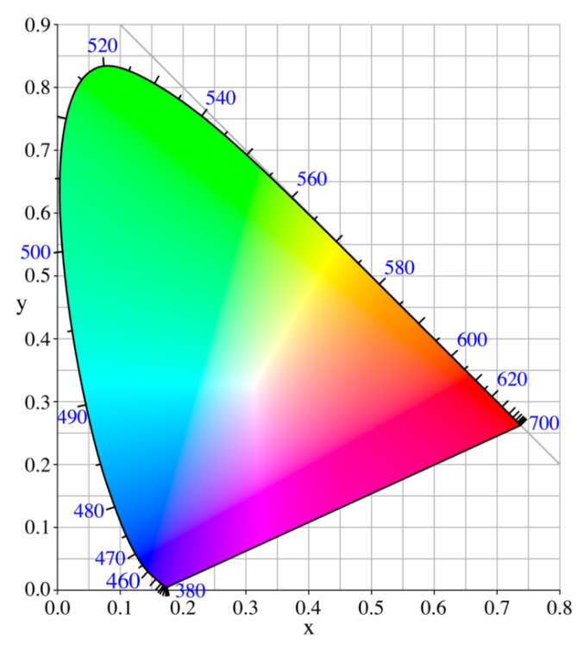
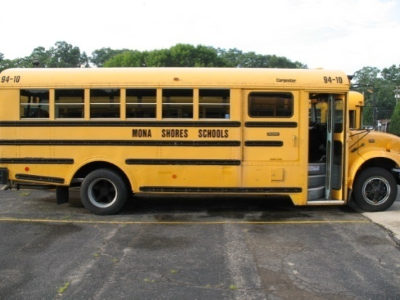
Distances in color space
Are distances between points in a color space perceptually meaningful?
Not necessarily: CIE XYZ is not a uniform color space, so magnitude of differences in coordinates are poor indicator of color “distance”.

Slide 17
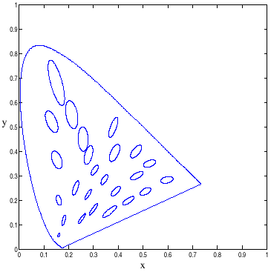
Uniform color spaces
Attempt to correct this limitation by remapping color space so that just-noticeable differences are contained by circles → distances more perceptually meaningful.
Examples:
CIE u’v’
CIE Lab
CIE XYZ
CIE u’v’
CIE LAB is now almost universally the most popular uniform color space

Slide 18
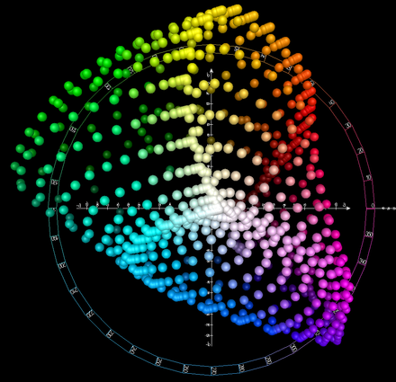
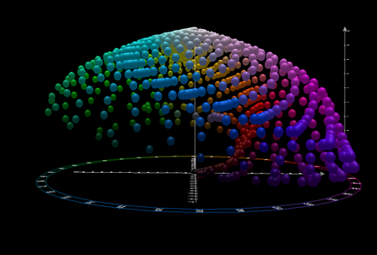
Linear color spaces: LAB space
Expresses color as three numerical values,
L* for the lightness
A* for the green–red color components
b* and blue–yellow color components.
Front view
Top view
Images obtained from https://en.wikipedia.org/wiki/CIELAB_color_space

Slide 19
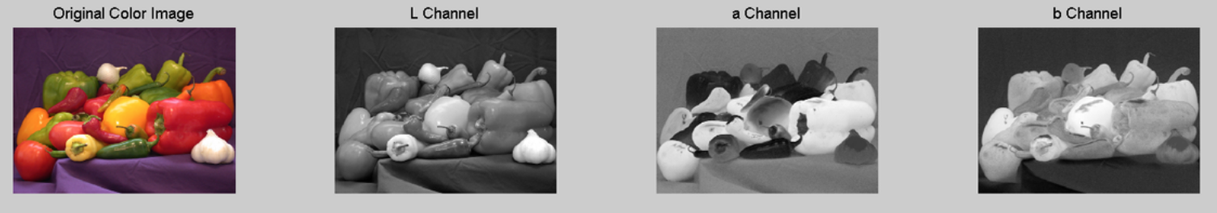
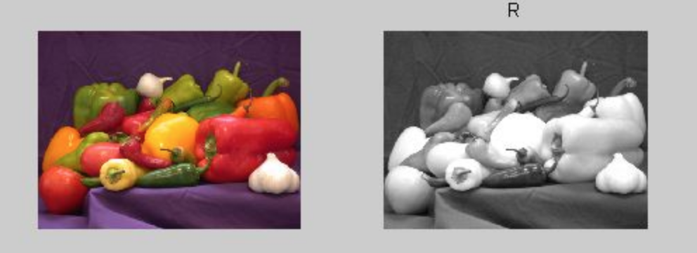
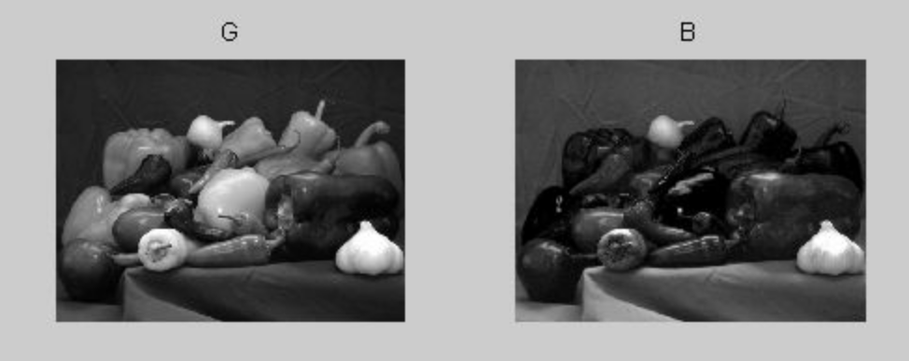
Linear color spaces: LAB space
Perceptually meaningful, by virtue of how it was designed
Distances in the colorspace correspond to similar quantities of visually perceived change.

Slide 20
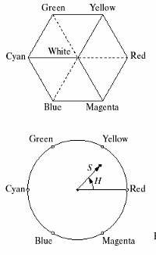
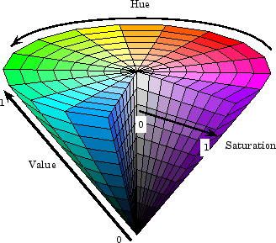
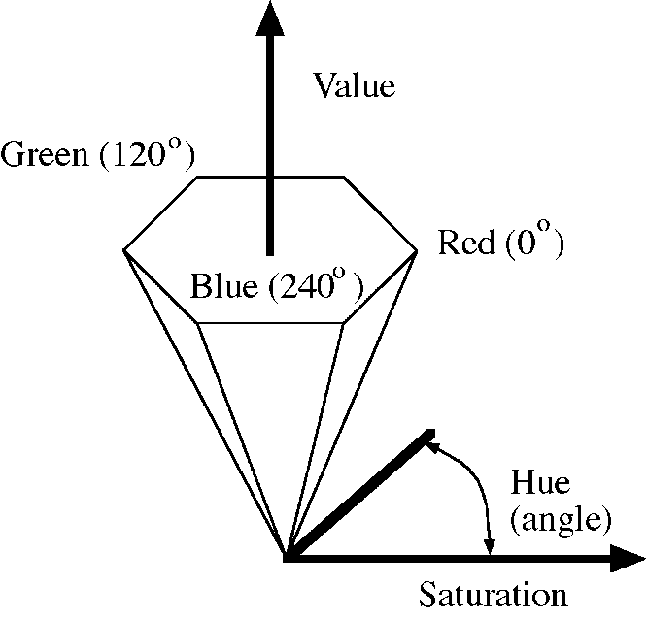
Nonlinear color spaces: HSV
Perceptually meaningful dimensions: Hue, Saturation, Value (Intensity)

Slide 21
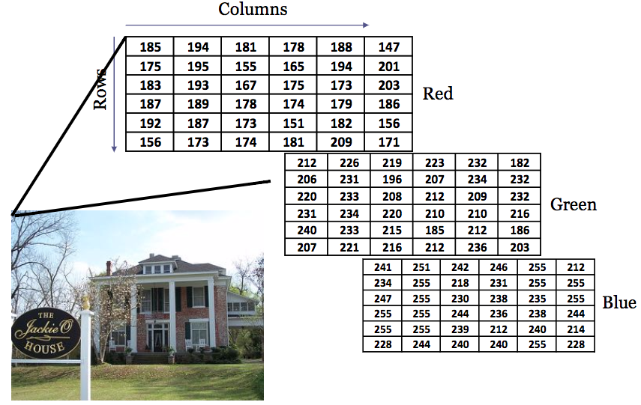
Pixel values

Slide 22
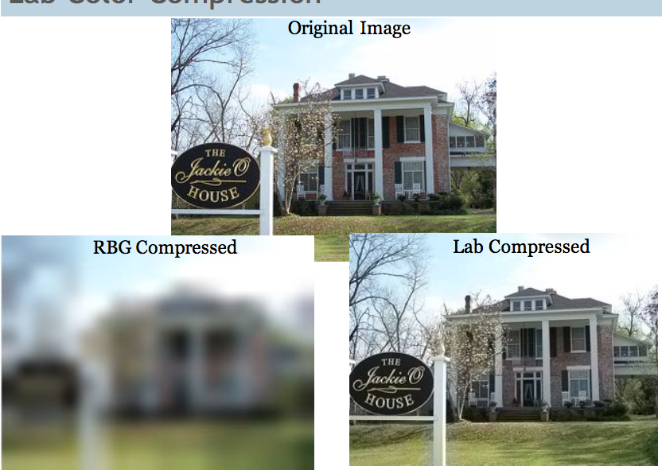
Color compression

Slide 23
Color
Human encoding of color
Physics of color
Applications in computer vision

Slide 24
Uses of color in computer vision
Color histograms for image matching
Swain and Ballard, Color Indexing, IJCV 1991.

Slide 25
Uses of color in computer vision
Image segmentation and retrieval
C. Carson, S. Belongie, H. Greenspan, and J. Malik, Blobworld: Image segmentation using Expectation-Maximization and its application to image querying, ICVIS 1999.

Slide 26
Uses of color in computer vision
Color-based image retrieval
Given collection (database) of images:
Extract and store one color histogram per image
Given new query image:
Extract its color histogram
For each database image:
Compute intersection between query histogram and database histogram
Sort intersection values (highest score = most similar)
Rank database items relative to query based on this sorted order

Slide 27
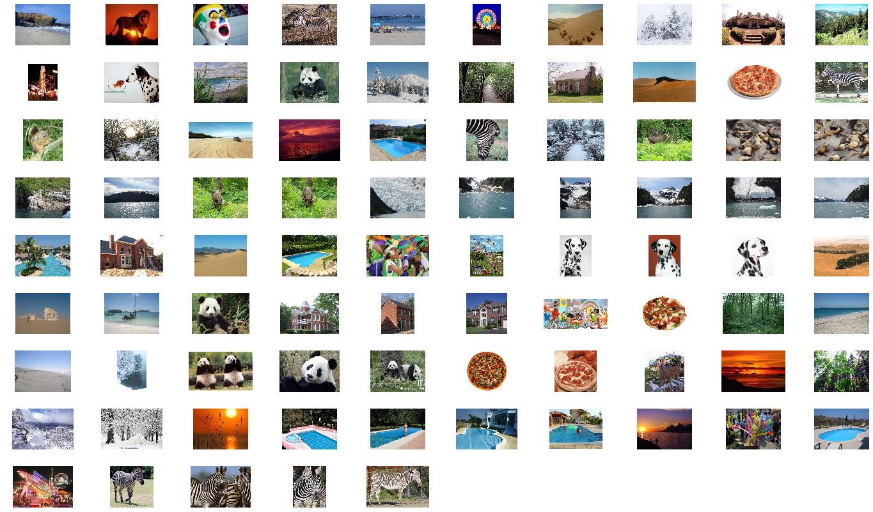
Example database
Color-based image retrieval

Slide 28
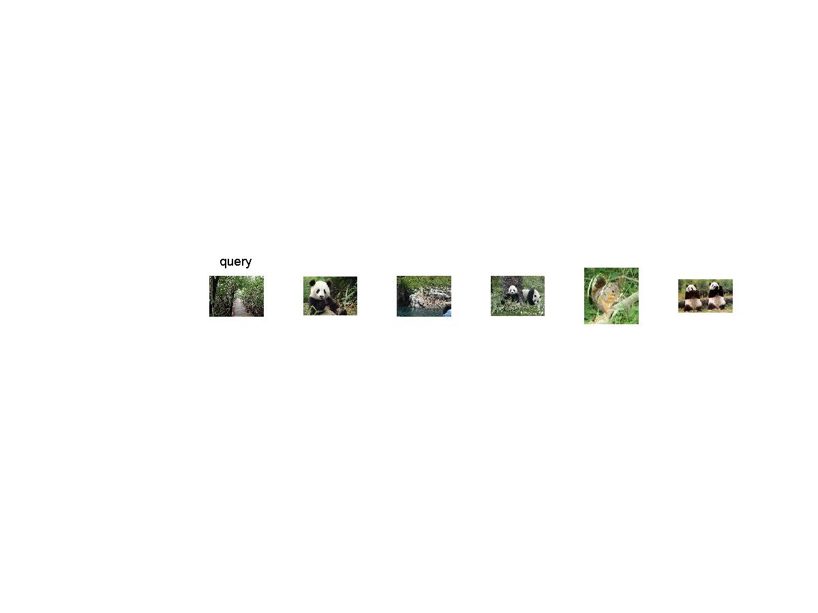
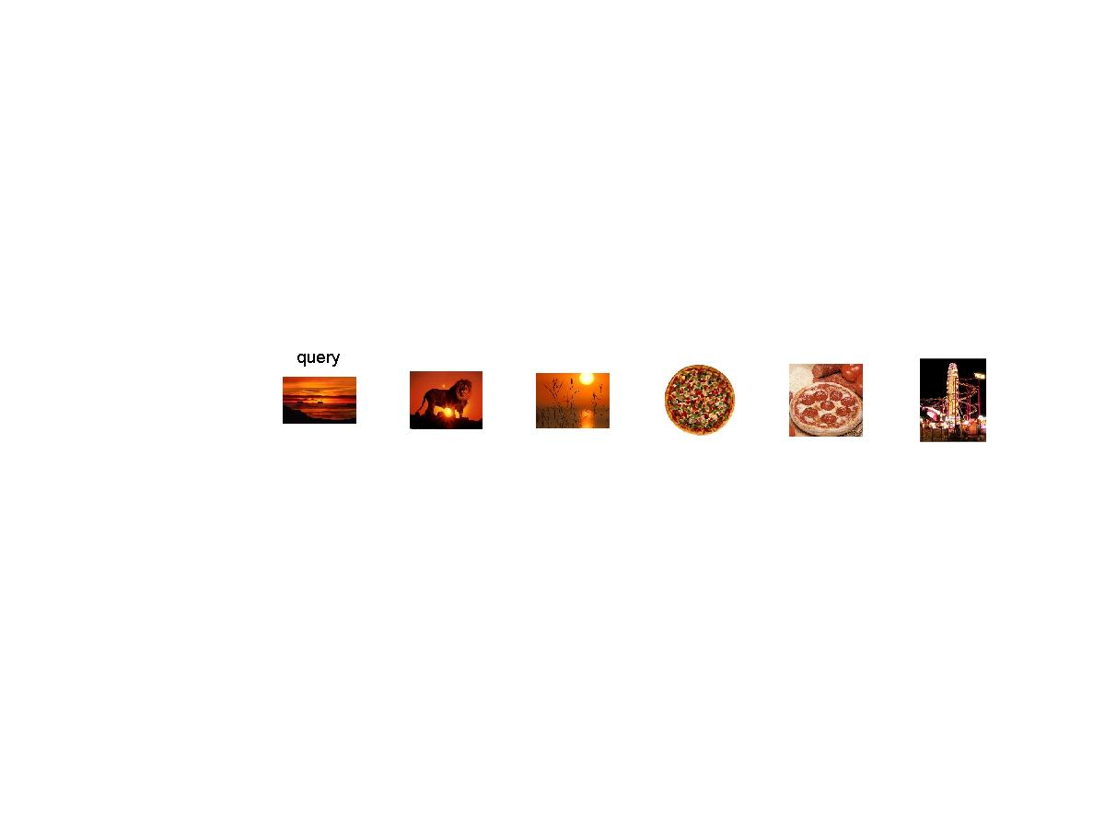
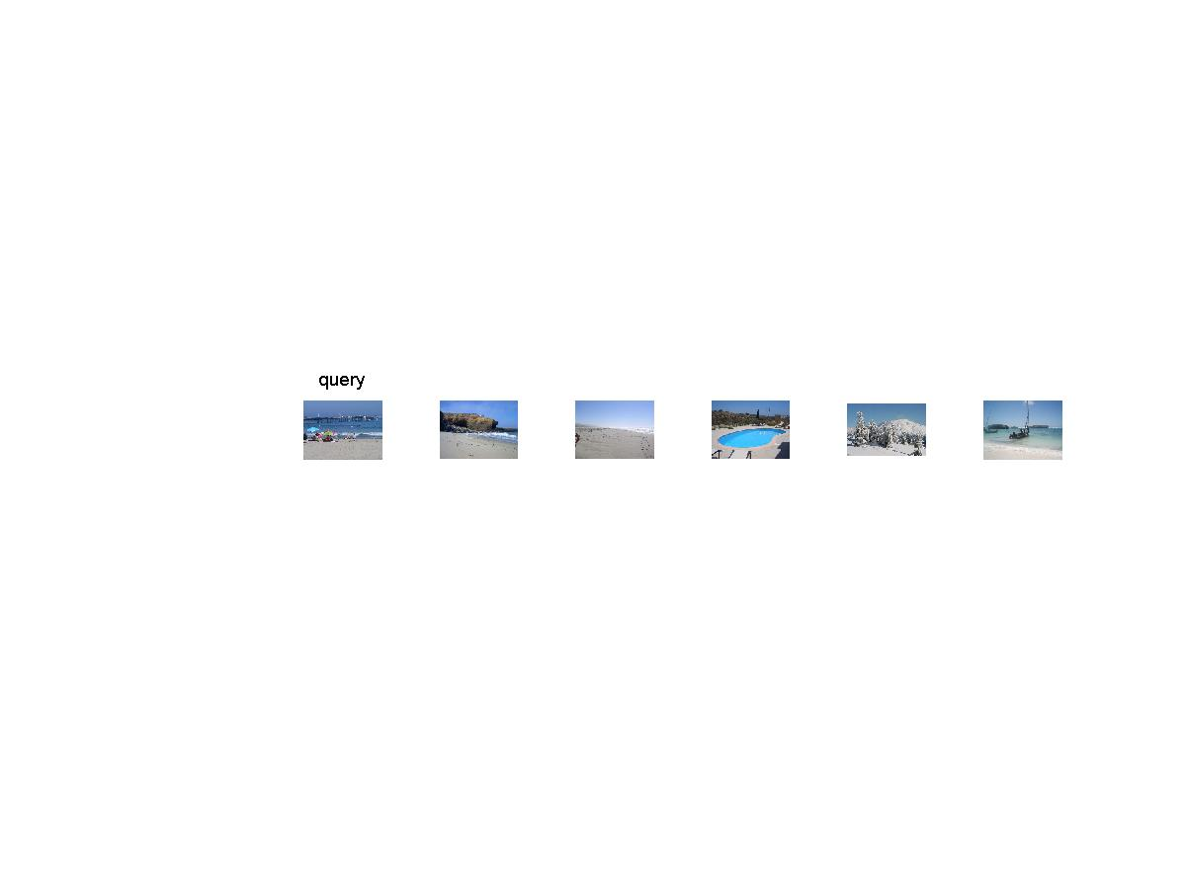
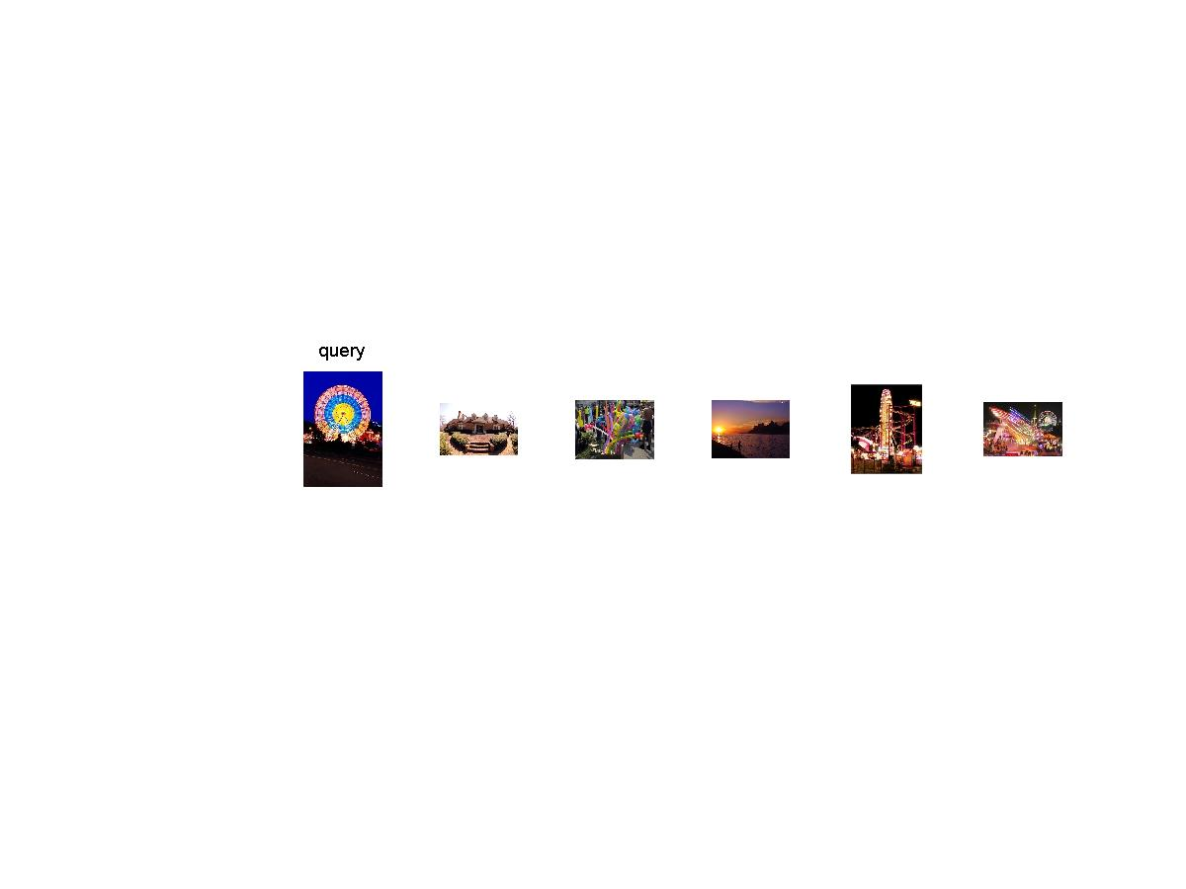
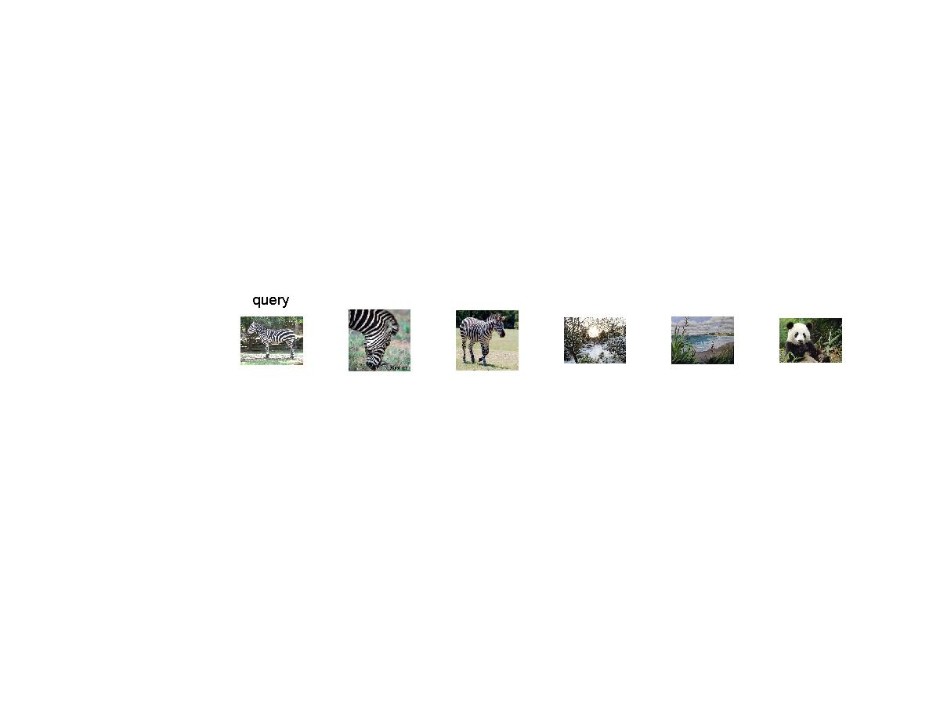
Example retrievals
Color-based image retrieval

Slide 29
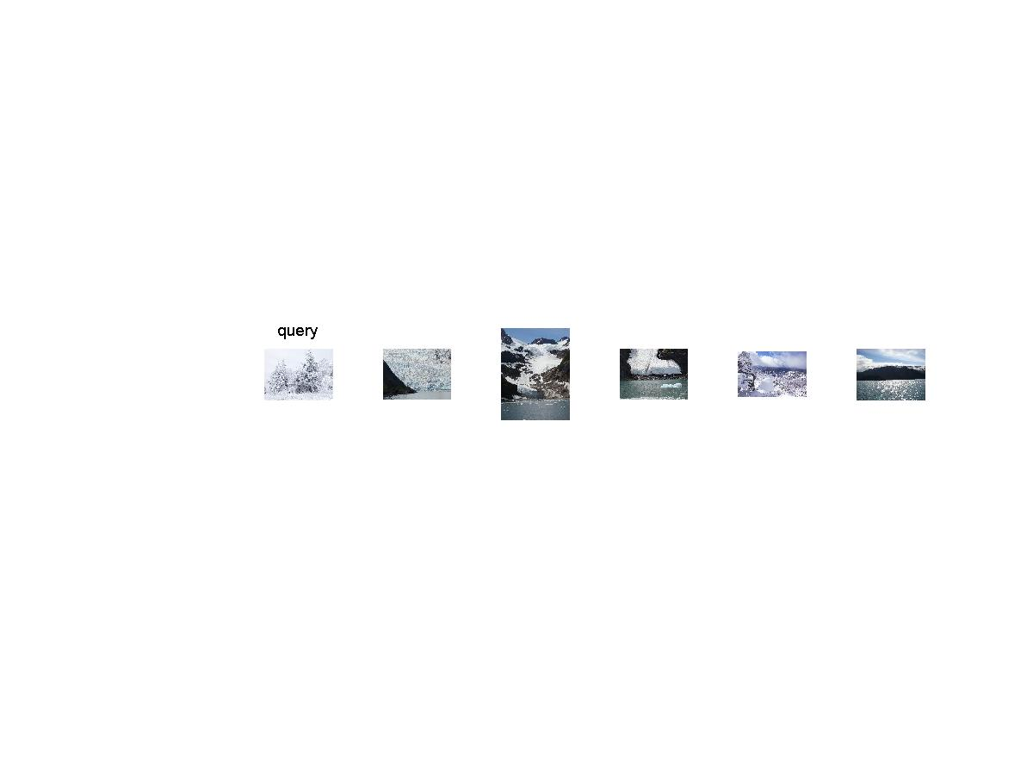
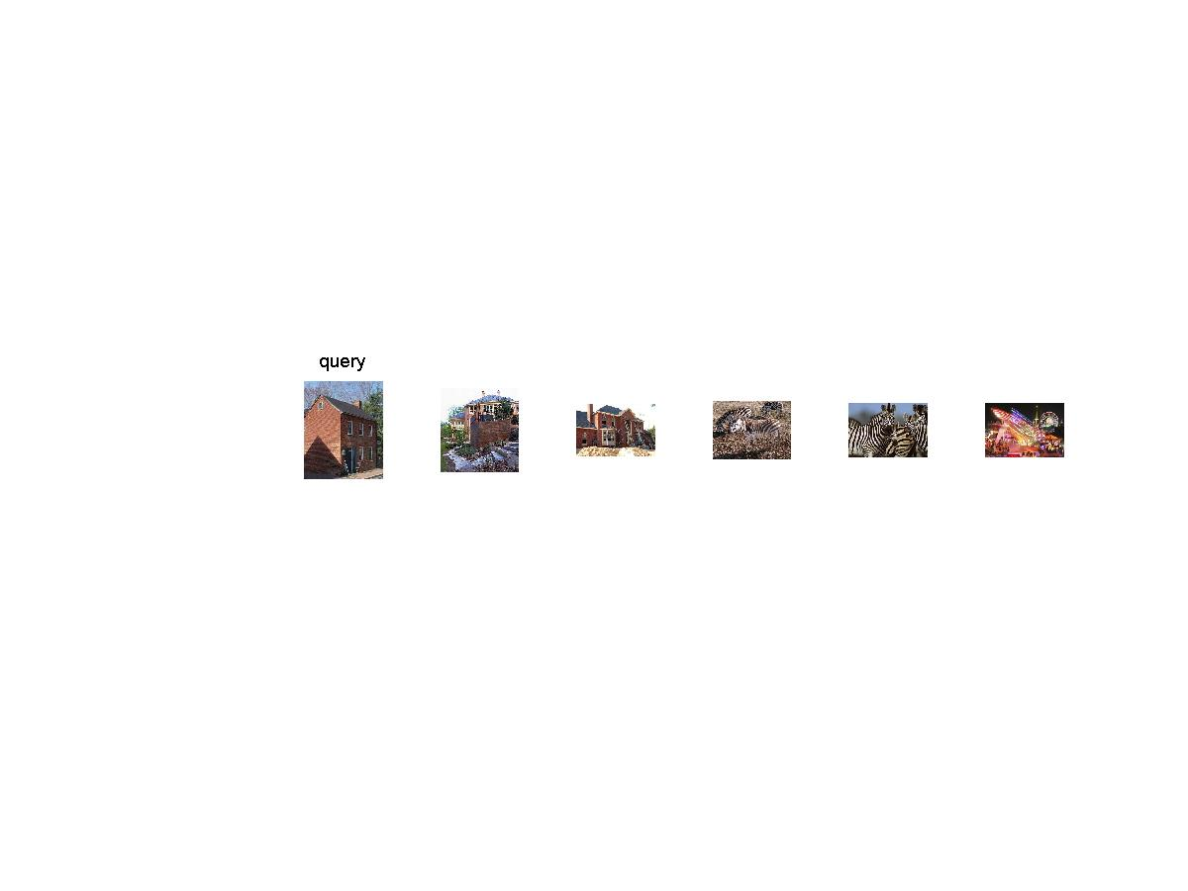
Example retrievals
Color-based image retrieval

Slide 30
Uses of color in computer vision
Skin detection
M. Jones and J. Rehg, Statistical Color Models with Application to Skin Detection, IJCV 2002.

Slide 31
Uses of color in computer vision
Building appearance models for tracking
D. Ramanan, D. Forsyth, and A. Zisserman. Tracking People by Learning their Appearance. PAMI 2007.

Slide 32
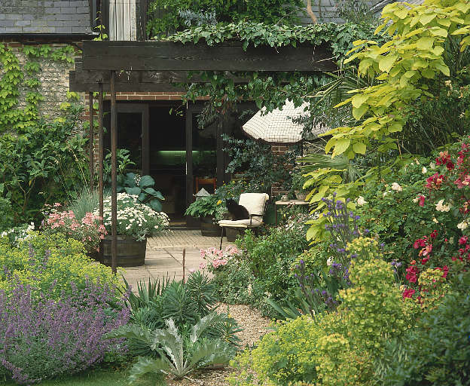
Texture
From F & P, used with permission

Slide 33
What is texture?
Patterns of structure from
changes in surface albedo (eg printed cloth)
changes in surface shape (eg bark)
many small surface patches (eg leaves on a bush)
Hard to define; but texture tells us
what a surface is like
(sometimes) object identity
(sometimes) surface shape

Slide 34
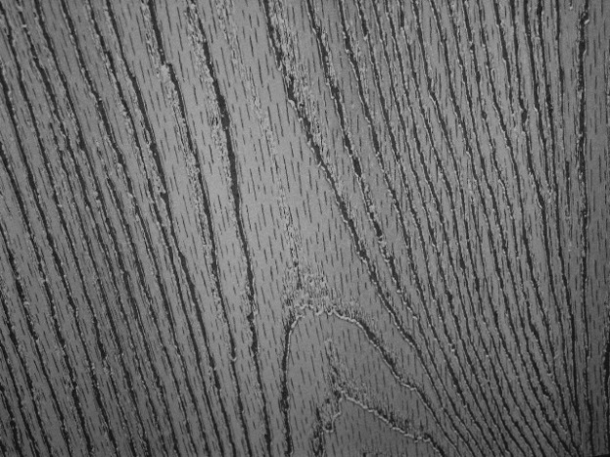
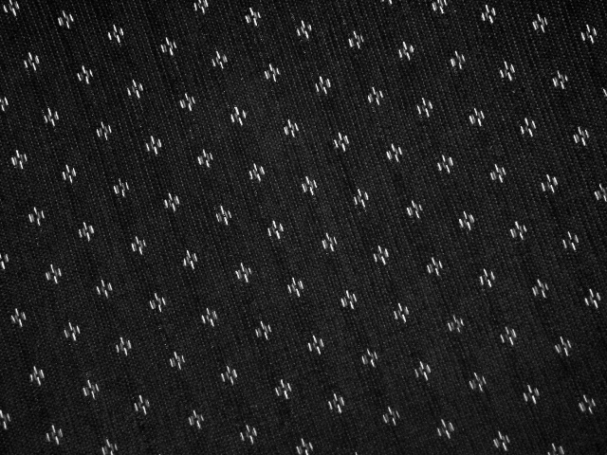
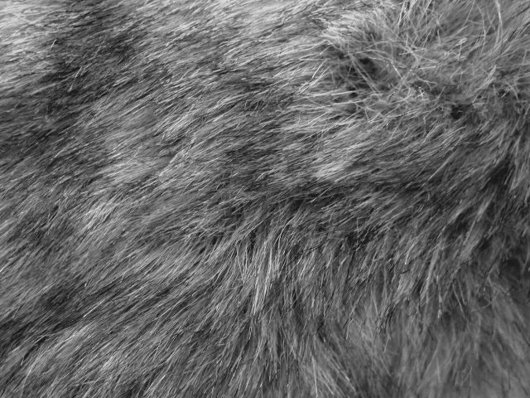
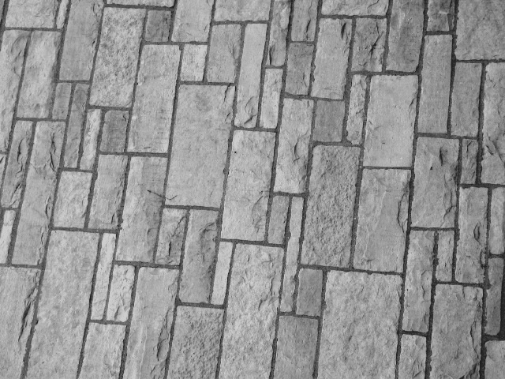
Texture and Material
http://www-cvr.ai.uiuc.edu/ponce_grp/data/texture_database/samples/

Slide 35
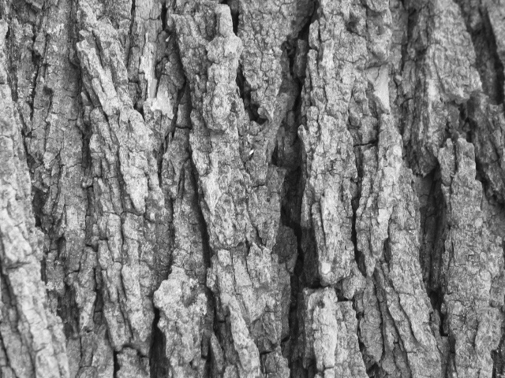
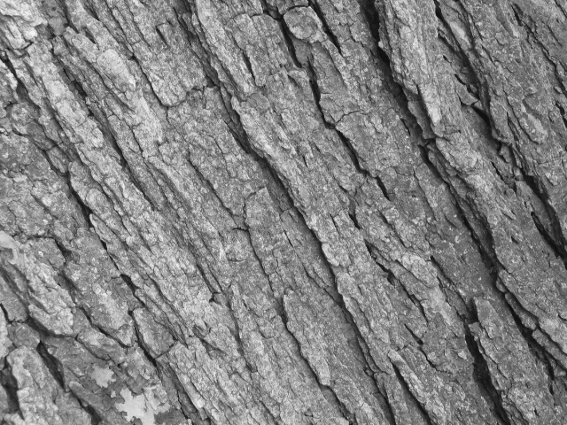
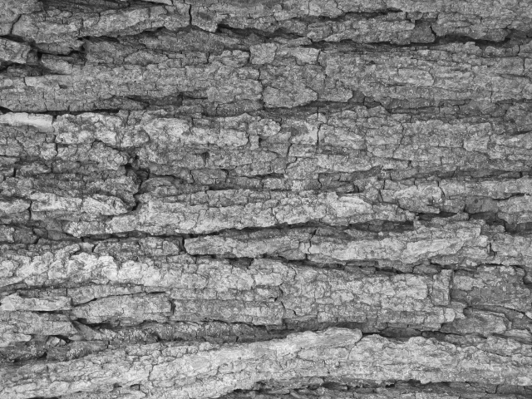
Texture and Orientation
http://www-cvr.ai.uiuc.edu/ponce_grp/data/texture_database/samples/

Slide 36
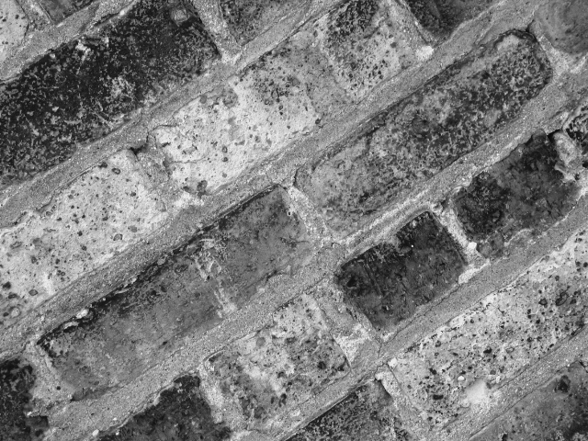
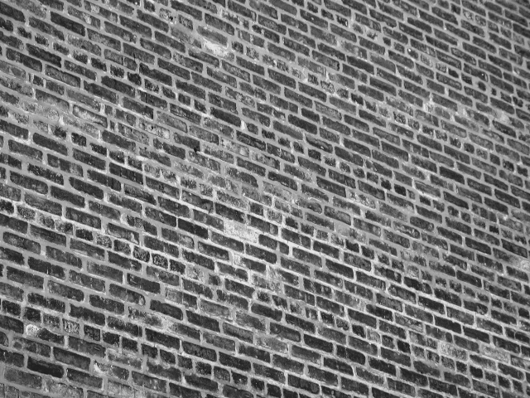
Texture and Scale
http://www-cvr.ai.uiuc.edu/ponce_grp/data/texture_database/samples/

Slide 37
Texture: Core Problems
Represent complex surface textures to recognize
objects
materials
textures
Synthesize texture from examples
to create big textures for computer graphics
to fill in holes in images caused by editing

Slide 38
Texture representation
Core idea: Textures consist of
a set of elements
repeated in some way
Representations
identify the elements
summarize the repetition

Slide 39
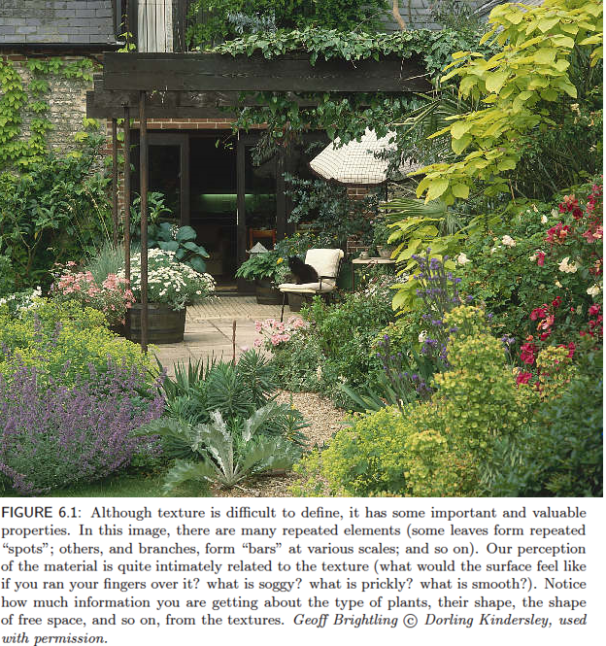
Notice how the change in
pattern elements and
repetitions is the main
difference between different
textured surfaces
(the plants, the ground, etc.)

Slide 40
Filter based texture representations
Choose a set of filters, each representing a pattern element
typically a spot and some oriented bars
Apply all the filter the image at a variety of scales
Rectify the filtered images
typically half wave, to avoid averaging contrast reversals
e.g. should not average dark spot on light background, light spot on dark background to zero

Slide 41
Filter based texture representations continued
Compute summaries of rectified filtered images
e.g. smoothed average
at a variety of scales to capture
nearby pattern elements and general picture of pattern elements
Now describe each pixel by vector of summaries
which could be very long

Slide 42
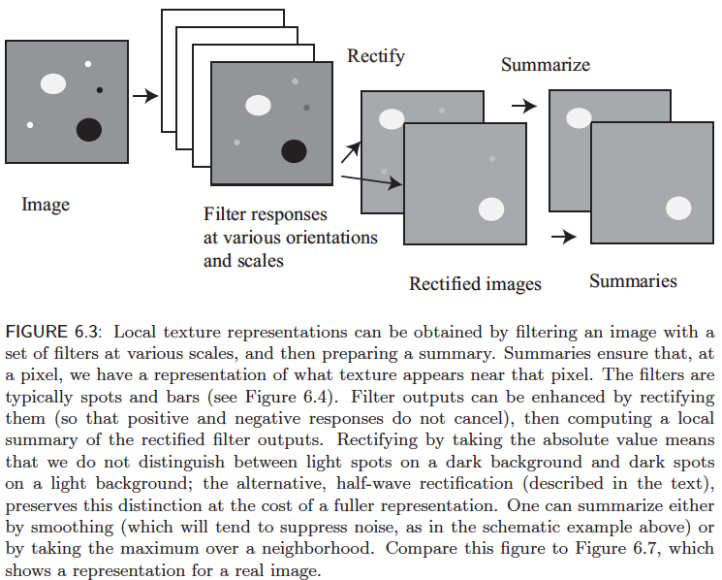

Slide 43
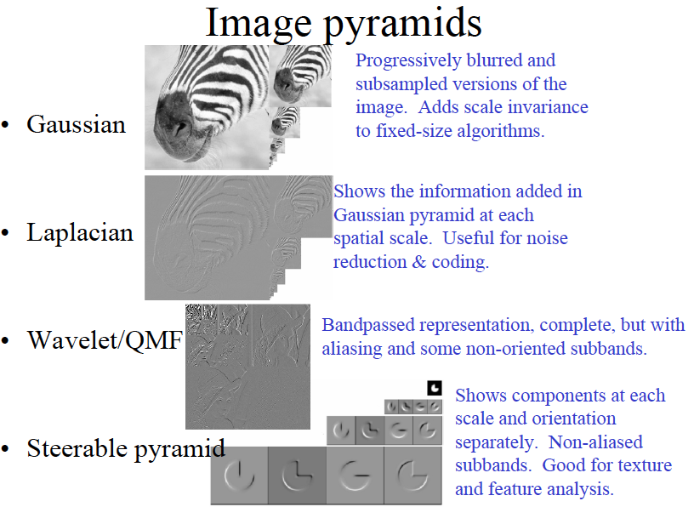

Slide 44
How can we represent texture?
Compute responses of blobs and edges at various orientations and scales

Slide 45
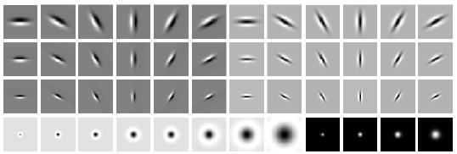
Overcomplete representation: filter banks
LM Filter Bank
Code for filter banks: www.robots.ox.ac.uk/~vgg/research/texclass/filters.html

Slide 46

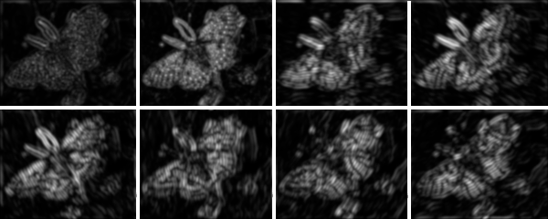
Filter banks
Process image with each filter and keep responses (or squared/abs responses)

Slide 47
Representing texture
Take the vectors of filter responses at each pixel and cluster them, then take histograms

Slide 48
Texture representation
Textures are made up of repeated local patterns, so:
Find the patterns
Use filters that look like patterns (spots, bars, raw patches…)
Consider magnitude of response
Describe their statistics within each local window
Mean, standard deviation
Histogram
Histogram of “prototypical” feature occurrences

Slide 49
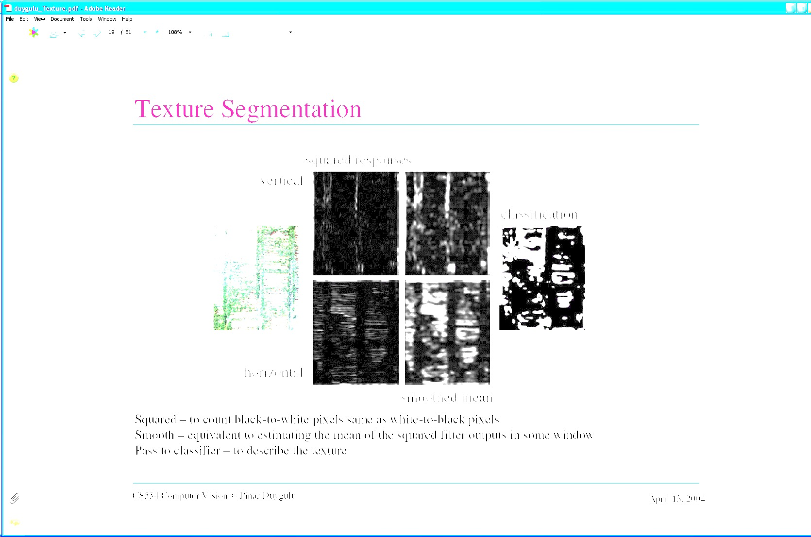
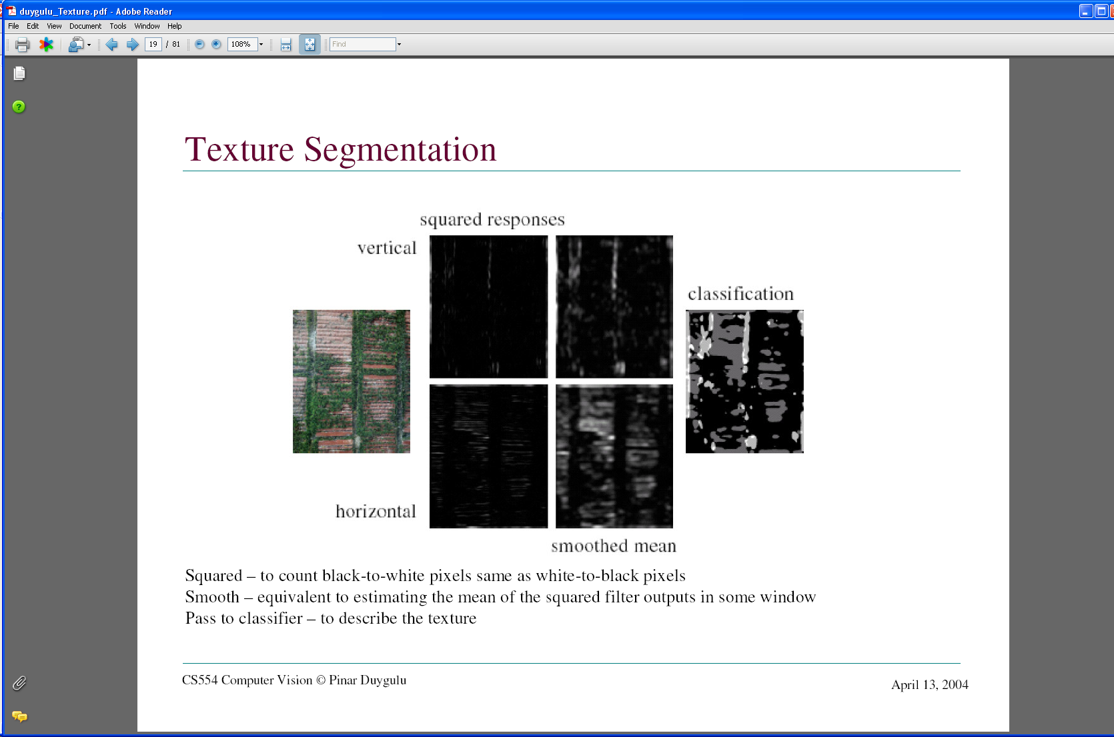
Texture representation: example
 | mean d/dx value | mean d/dy value
Win. #1 | 4 | 10
original image
…
statistics to summarize patterns in small windows
derivative filter responses, squared

Slide 50
Texture representation: example
 | mean d/dx value | mean d/dy value
Win. #1 | 4 | 10
Win.#2 | 18 | 7
original image
…
statistics to summarize patterns in small windows
derivative filter responses, squared

Slide 51
Texture representation: example
 | mean d/dx value | mean d/dy value
Win. #1 | 4 | 10
Win.#2 | 18 | 7
original image
…
statistics to summarize patterns in small windows
derivative filter responses, squared

Slide 52
Texture representation: example
 | mean d/dx value | mean d/dy value
Win. #1 | 4 | 10
Win.#2 | 18 | 7
Win.#9 | 20 | 20
original image
…
…
statistics to summarize patterns in small windows
derivative filter responses, squared

Slide 53
Texture representation: example
 | mean d/dx value | mean d/dy value
Win. #1 | 4 | 10
Win.#2 | 18 | 7
Win.#9 | 20 | 20
Dimension 2 (mean d/dy value)
Dimension 1 (mean d/dx value)
…
…
statistics to summarize patterns in small windows

Slide 54
Texture representation: example
Windows with primarily horizontal edges
Both
 | mean d/dx value | mean d/dy value
Win. #1 | 4 | 10
Win.#2 | 18 | 7
Win.#9 | 20 | 20
Dimension 2 (mean d/dy value)
Dimension 1 (mean d/dx value)
…
…
Windows with small gradient in both directions
Windows with primarily vertical edges
statistics to summarize patterns in small windows

Slide 55
Texture representation: example
original image
visualization of the assignment to texture “types”
derivative filter responses, squared

Slide 56
Texture representation: example
 | mean d/dx value | mean d/dy value
Win. #1 | 4 | 10
Win.#2 | 18 | 7
Win.#9 | 20 | 20
Dimension 2 (mean d/dy value)
Far: dissimilar textures
Close: similar textures
Dimension 1 (mean d/dx value)
…
…
statistics to summarize patterns in small windows

Slide 57
Example based texture representations
Q: how does one choose the filters?
Responses to over-complete filter banks
build histograms over filter responses
describe textures using clusters of responses
Alternative
build a vocabulary of pattern elements from pictures
describe textures using this vocabulary

Slide 58
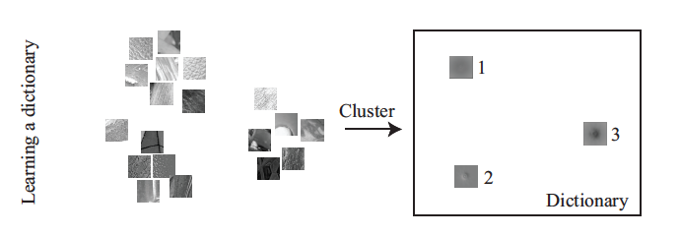
Building a vocabulary
There are 2 steps to building a pooled texture representation for texture in an image domain.
Build a dictionary representing the range of possible pattern elements, using a large number of texture patches
Vectorize the patches in images using the clusters learned

Slide 59
Building a dictionary
Collect many training example textures
Construct the vectors x for the relevant pixels; these could be a reshaping of a patch around the pixel or a vector of filter outputs computed at the pixel
Obtain k cluster centers c for these examples

Slide 60
Representing an image domain
For each relevant pixel pixel I in the image
Compute the vector representation x_{i} for that pixel
Obtain j, the index of the cluster center c_{j} closest to that pixel
Insert j into a histogram for that domain

Slide 61

Clustering the examples
For using k-means we can represent patches with
intensity vector
vector of filter responses over pixel/patch

Slide 62

Representing a region
Vector Quantization
Represent a high-dimensional data item with a single number
Find the number of the nearest cluster center in dictionary
Use that to represent the cluster
Summarize the pattern of patches
Cut region into patches
Vector quantize - vector quantized image patches are sometimes called visual words
Build histogram of resulting numbers

Slide 63


Slide 64


Slide 65


Slide 66
Texture representations
A vector summarizing the trends in pattern elements
either overall trend in filter responses
or histogram of vector quantized patches
At a pixel
compute representations for domains centered on the pixel
For a region
compute representations the whole region

Slide 67
Texture: crucial points
Texture is the result of repetition of pattern elements
Representation of textures
vocabulary of pattern elements
either filters or visual words
summary of how they repeat
local averages of rectified filter responses or histograms

Slide 68
Slide Credits
David A. Forsyth - UIUC
Derek Hoeim – UIUC
Jana Kosecka - GMU

Slide 69

Questions

